Slide 1
Hospital Database
Dr. Ibrahim Elsemman

Slide 2
The Tables
Clinics
Doctors
Nurses
Employees
Medical Record (Junction table)
Reservation
Patients

Slide 3
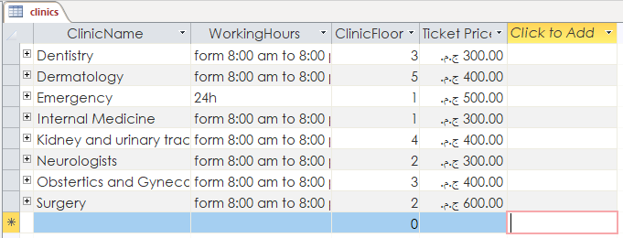
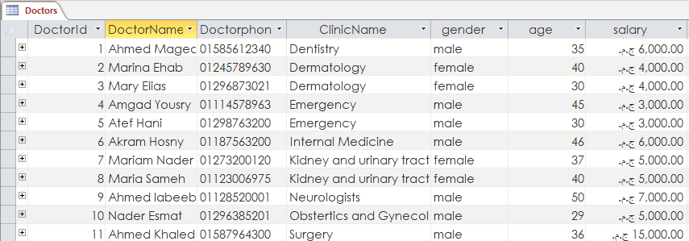
Clinics
Doctors

Slide 4
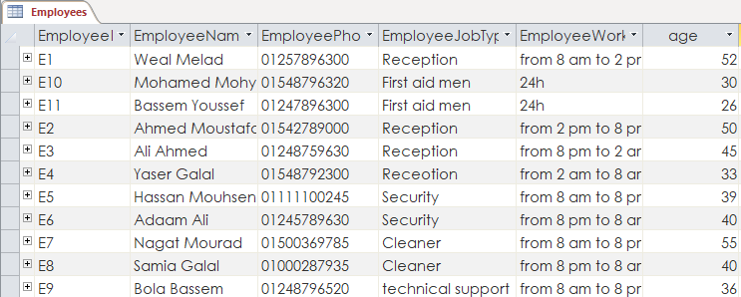
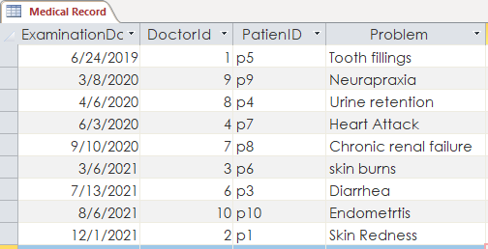
Employees
Medical Record

Slide 5
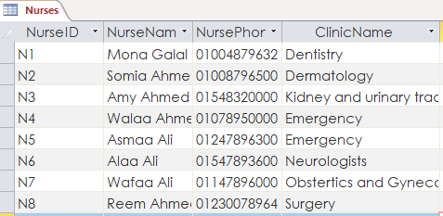
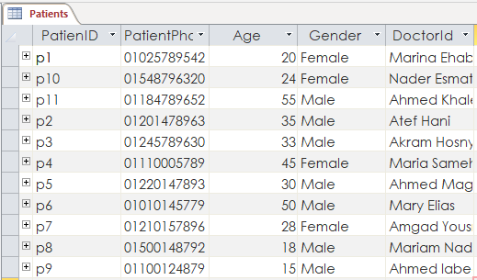
Nurses
Patients

Slide 6
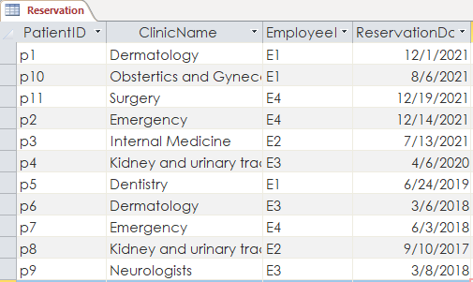
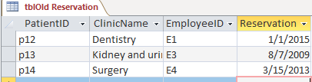
Reservation
Table Old Reservation

Slide 7
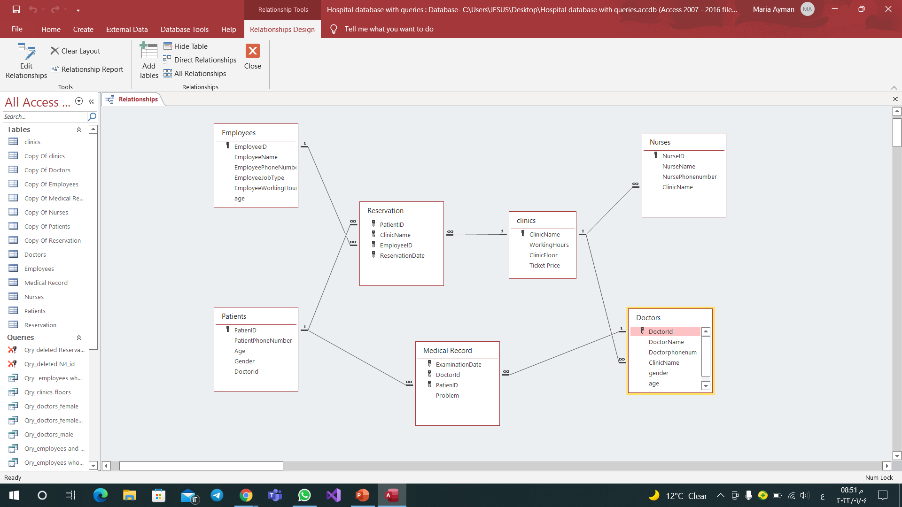
Entity Relationship Diagram

Slide 8
Relations
Nurses – Clinics (one to many)
One nurse has only one clinic,
but one clinic may have more
than one nurse.
Doctors – Clinics (one to many)
One doctor has only one clinic,
but one clinic may have more
than one doctor.

Slide 9
Doctors – Medical Record (one to many)
One medical record belongs to
one doctor, but one doctor may
have more than one medical record.
Clinics – Reservation (one to many)
One reservation belongs to one
clinic, but one clinic may have more
than one reservation.

Slide 10
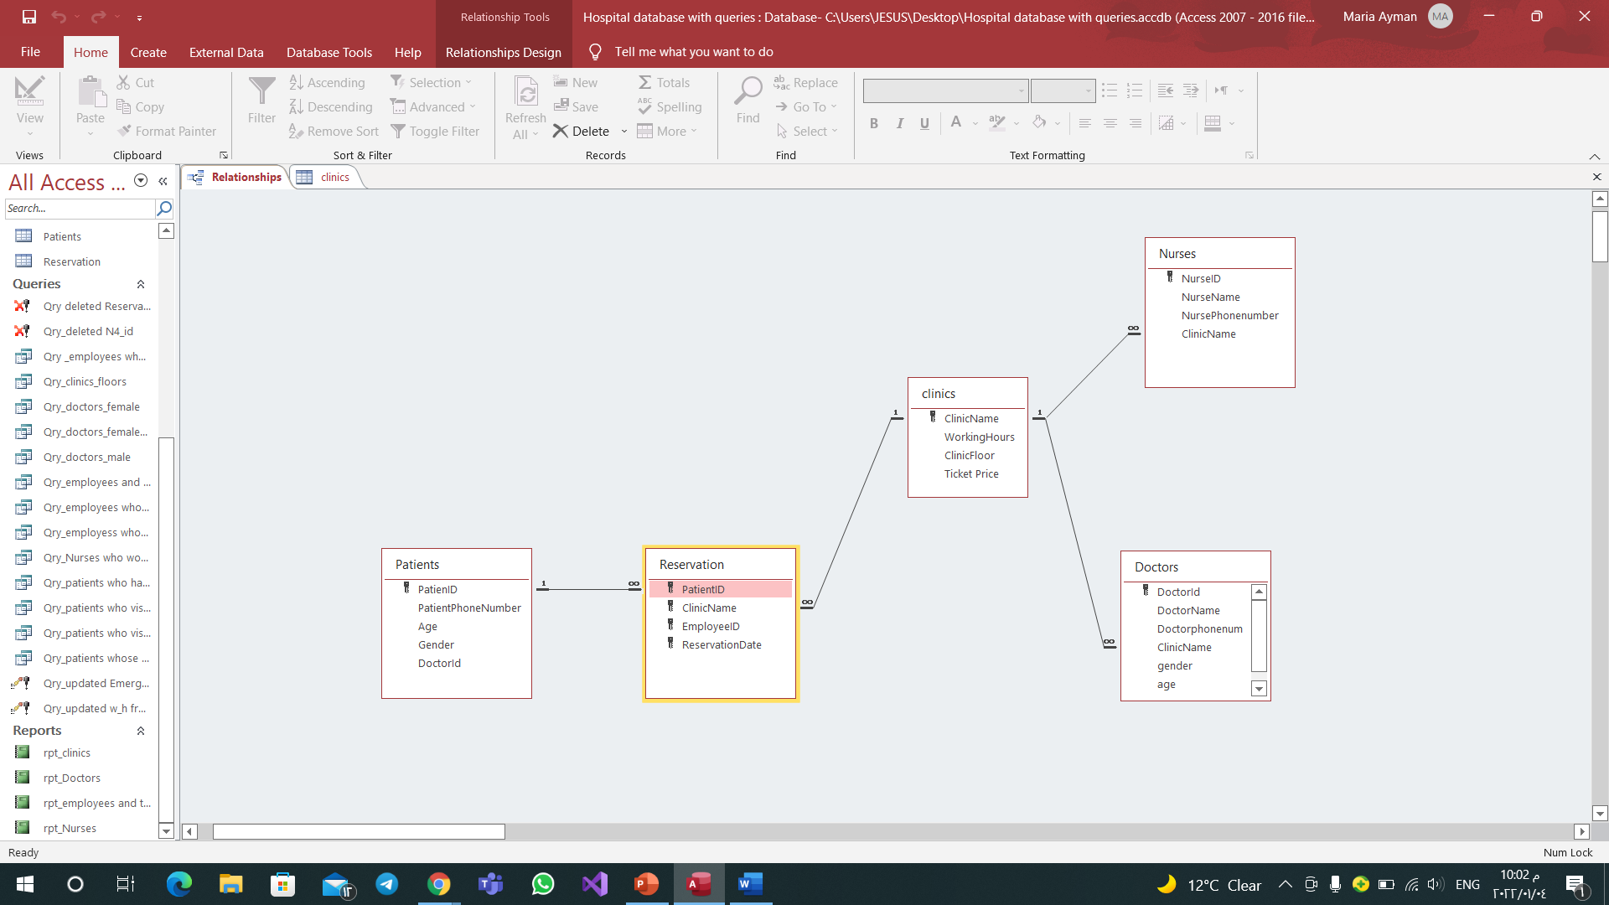
Reservation – Employees (one to many)
One reservation is made by one
employee, but one employee can
make one reservation.
Reservation – Patients (one to many)
One reservation belongs to one
patient, but one patient may
have more than one reservation.

Slide 11

Patients – Medical Record (one to many)
Medical record belongs to only one patient, but one patient may has more than one medical record.
According to the relationship between Doctors table and Patients table (many to many), we made Junction table called Medical Record.

Slide 12
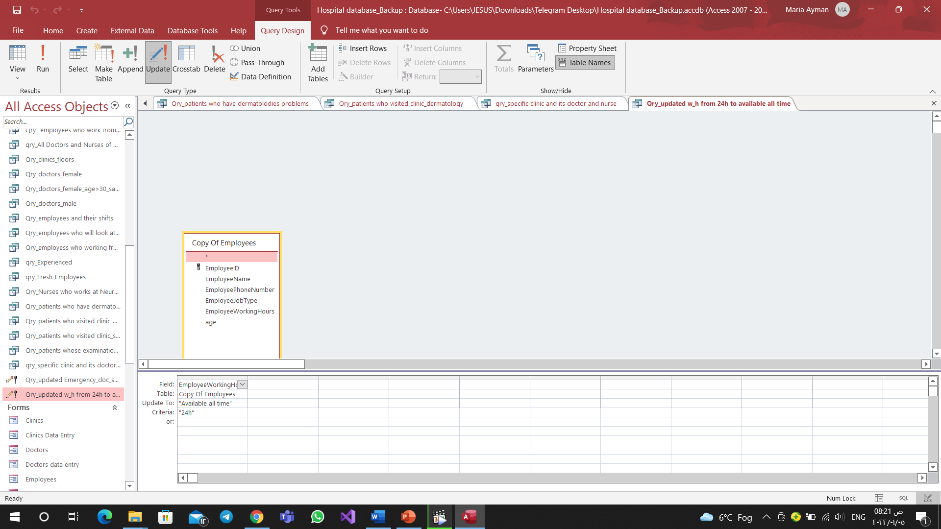
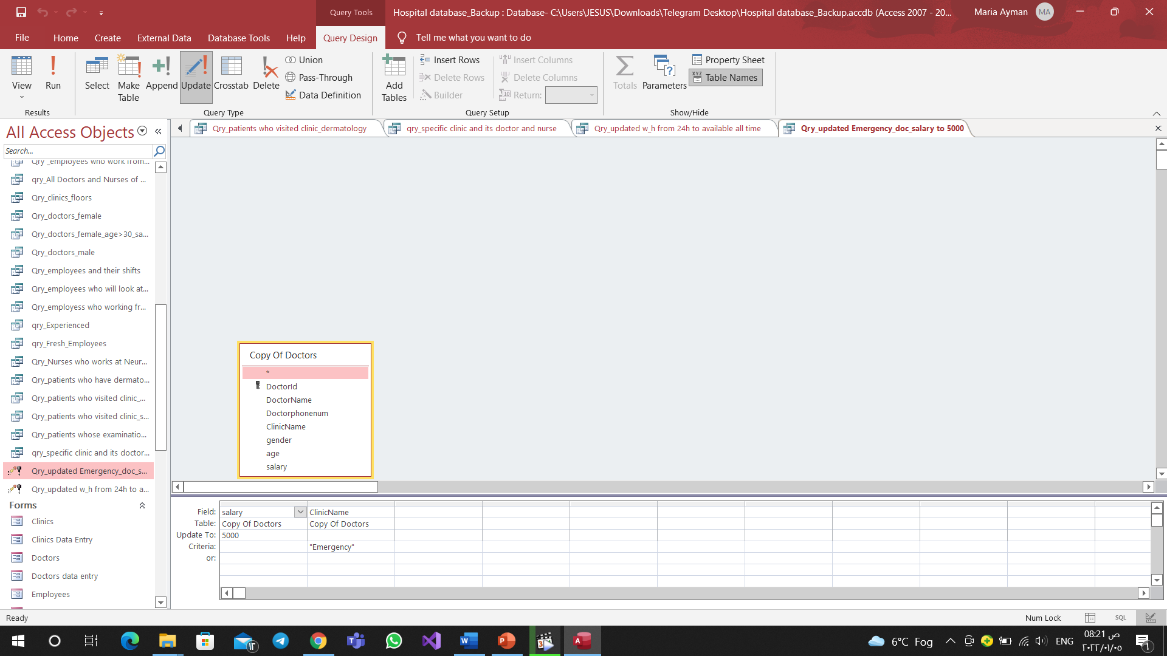
Queries
We made 24 queries (17 select and 7 action queries)
Updated query →

Slide 13
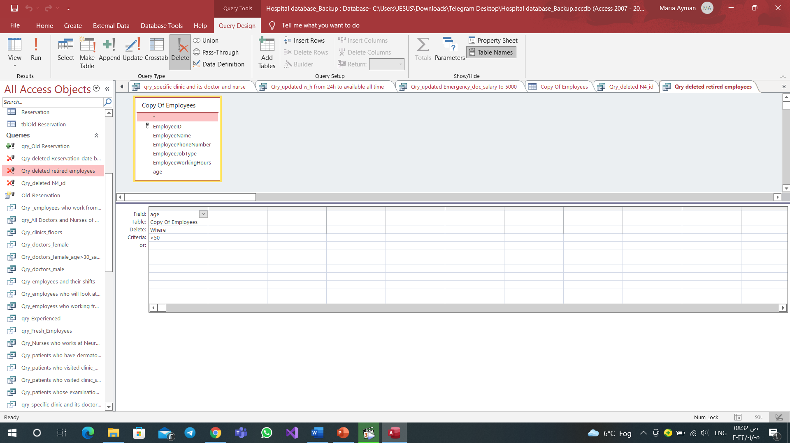
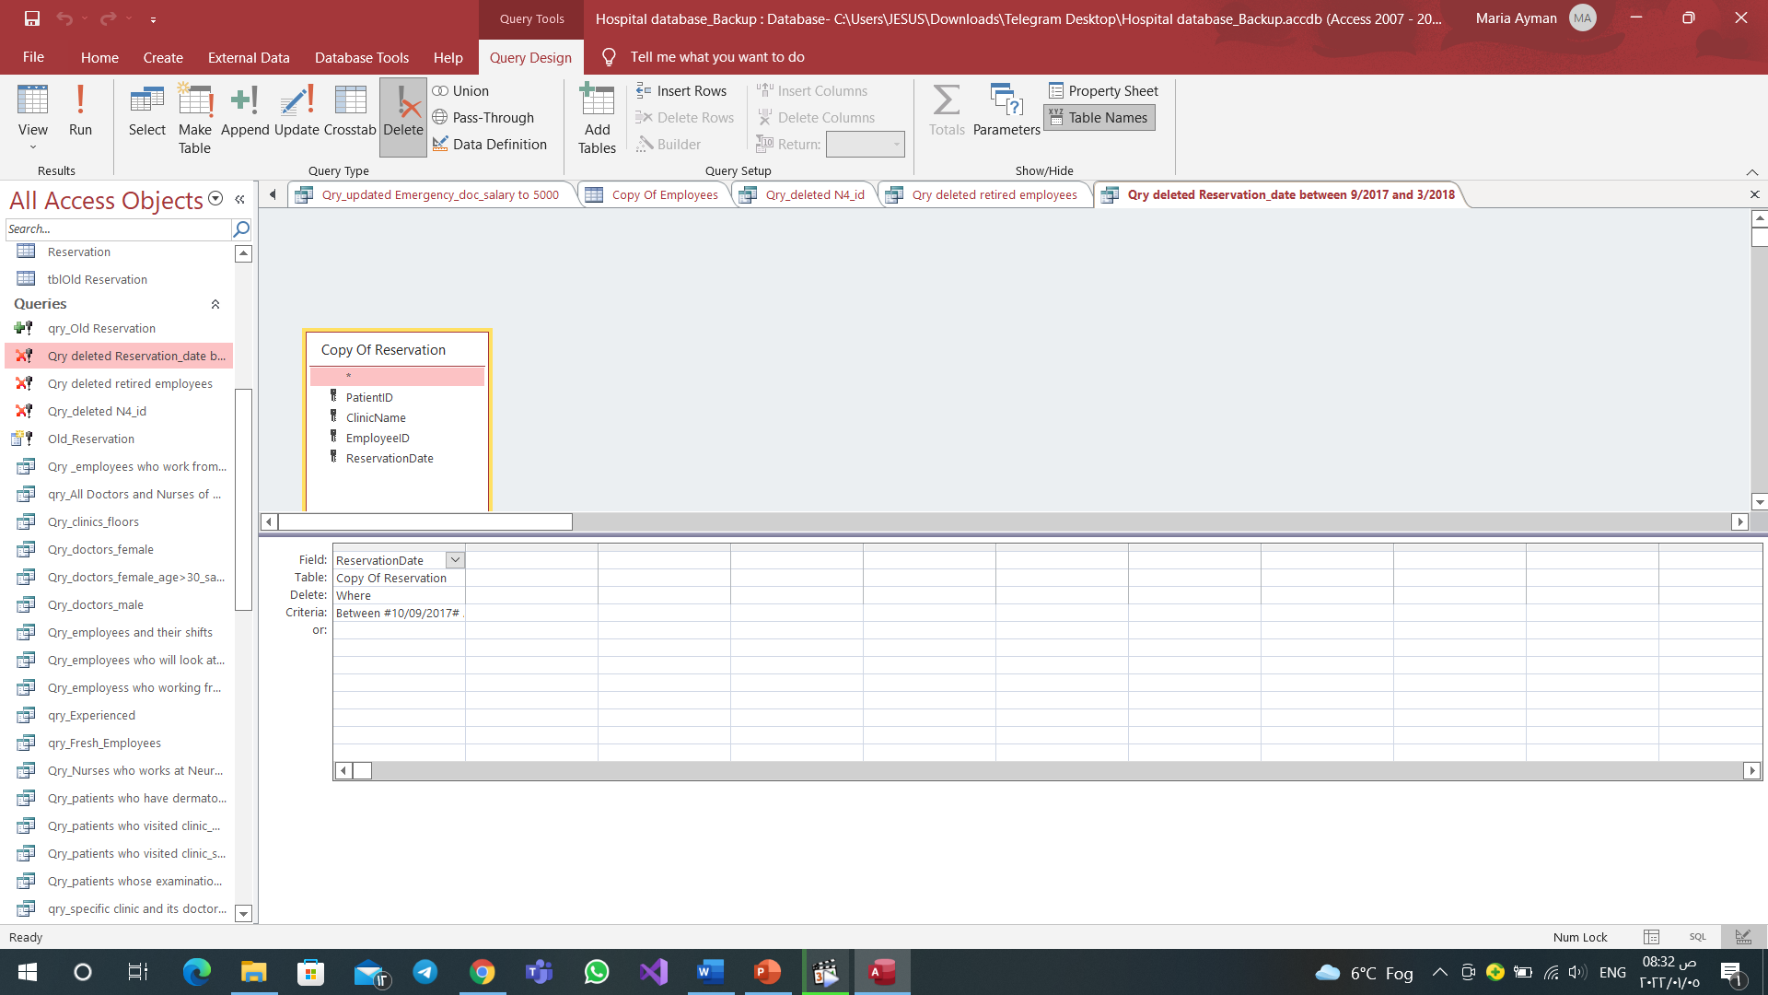
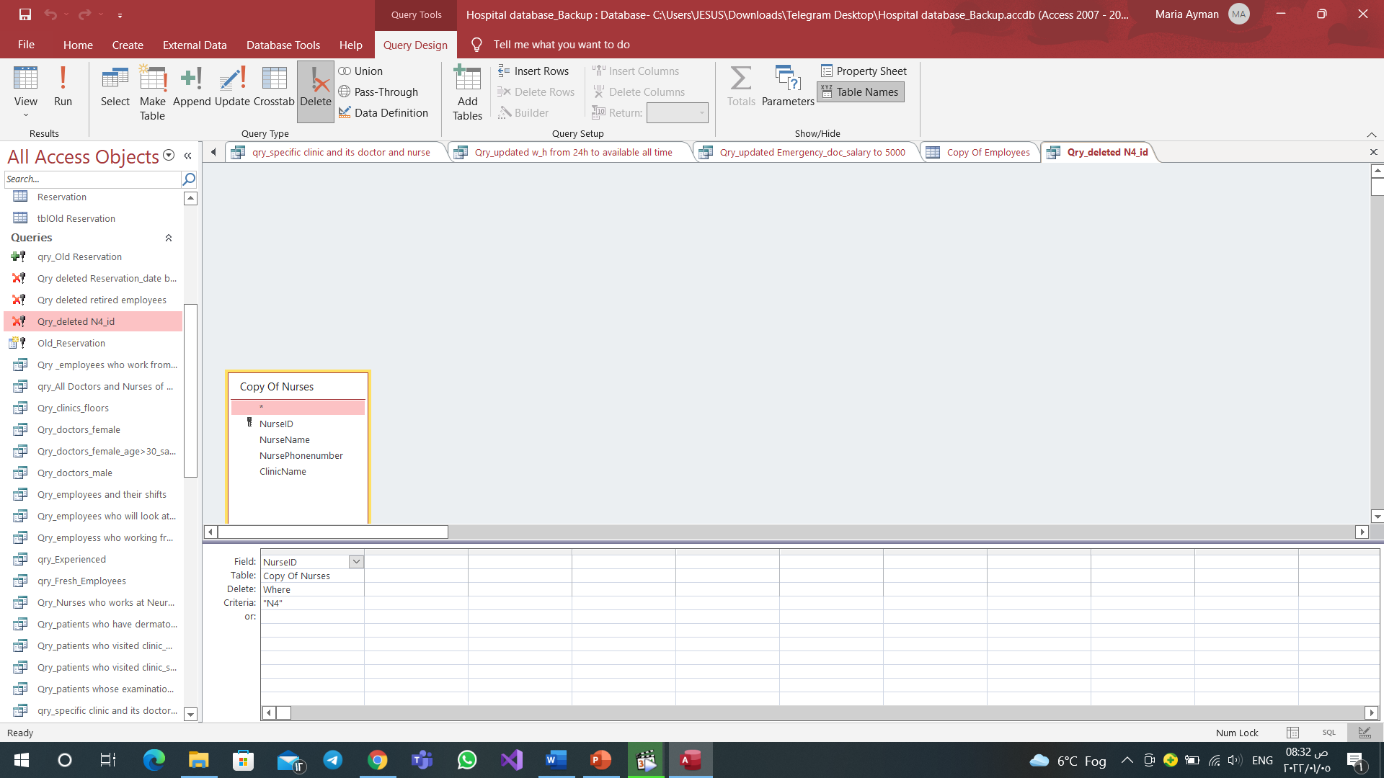
Deleted query→

Slide 14
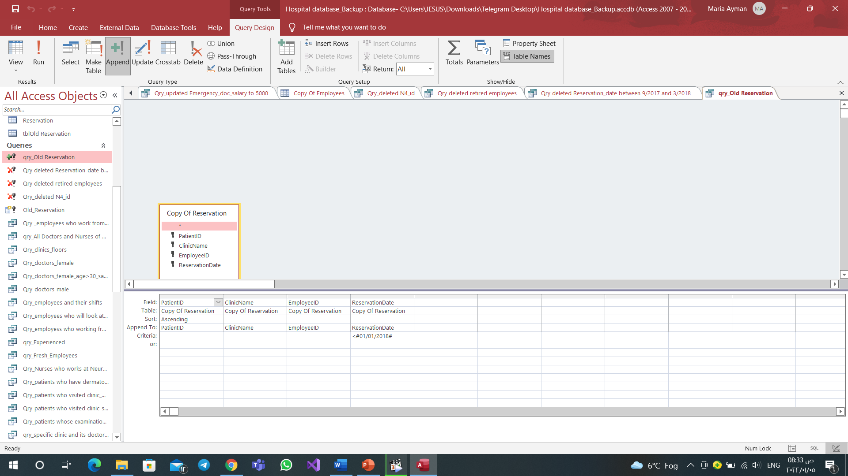
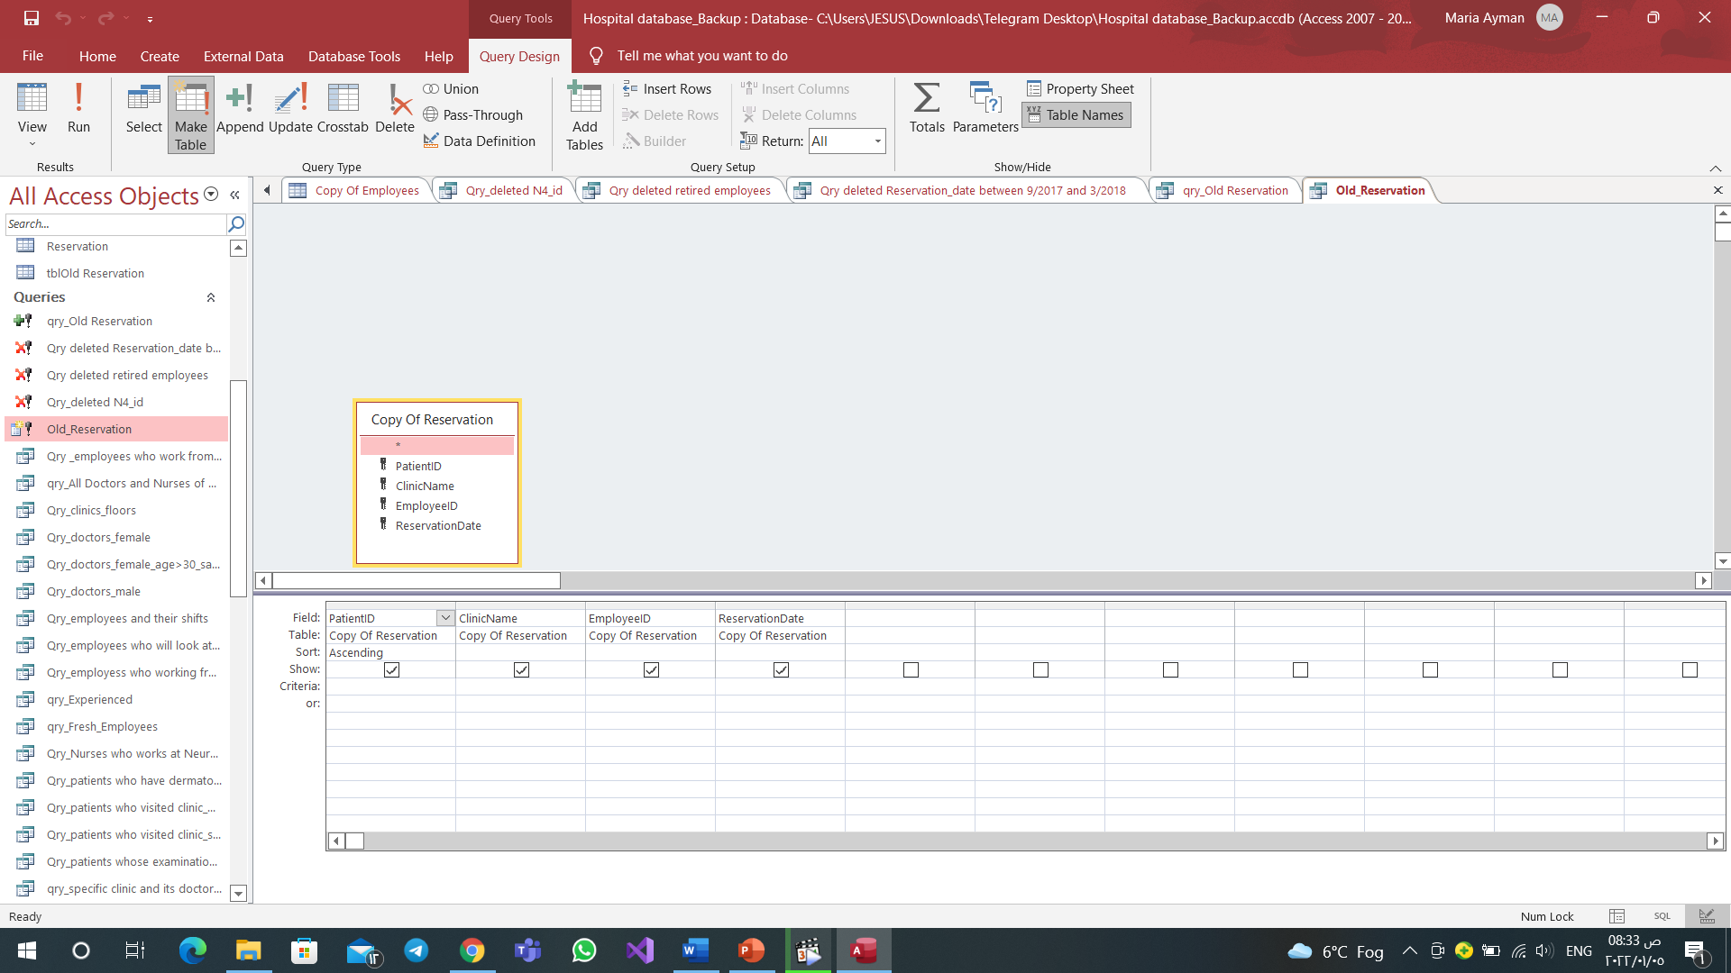
Make Table Append

Slide 15
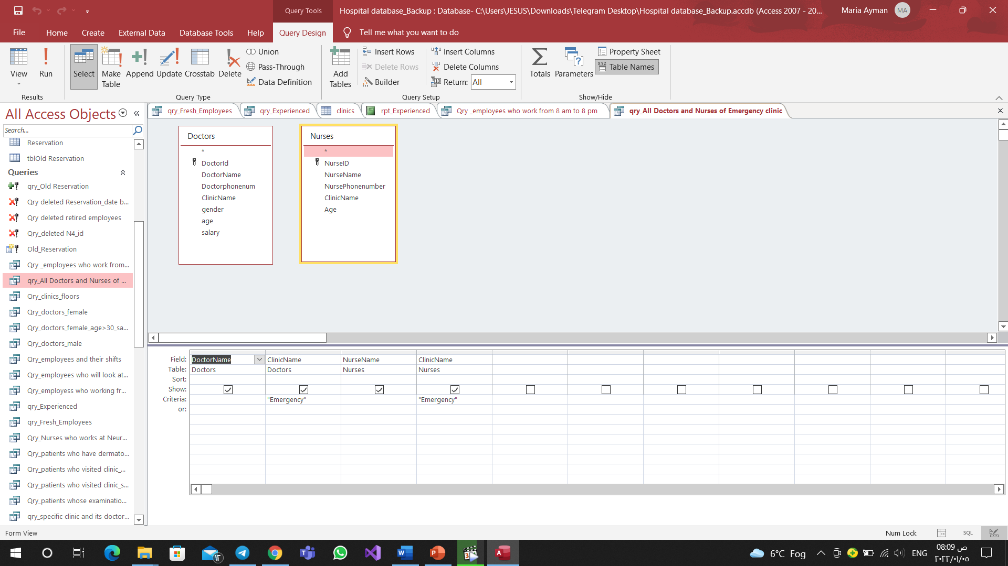
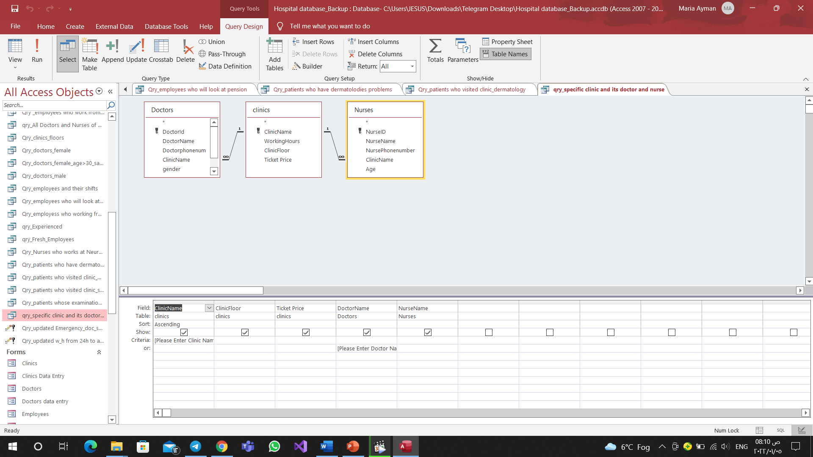
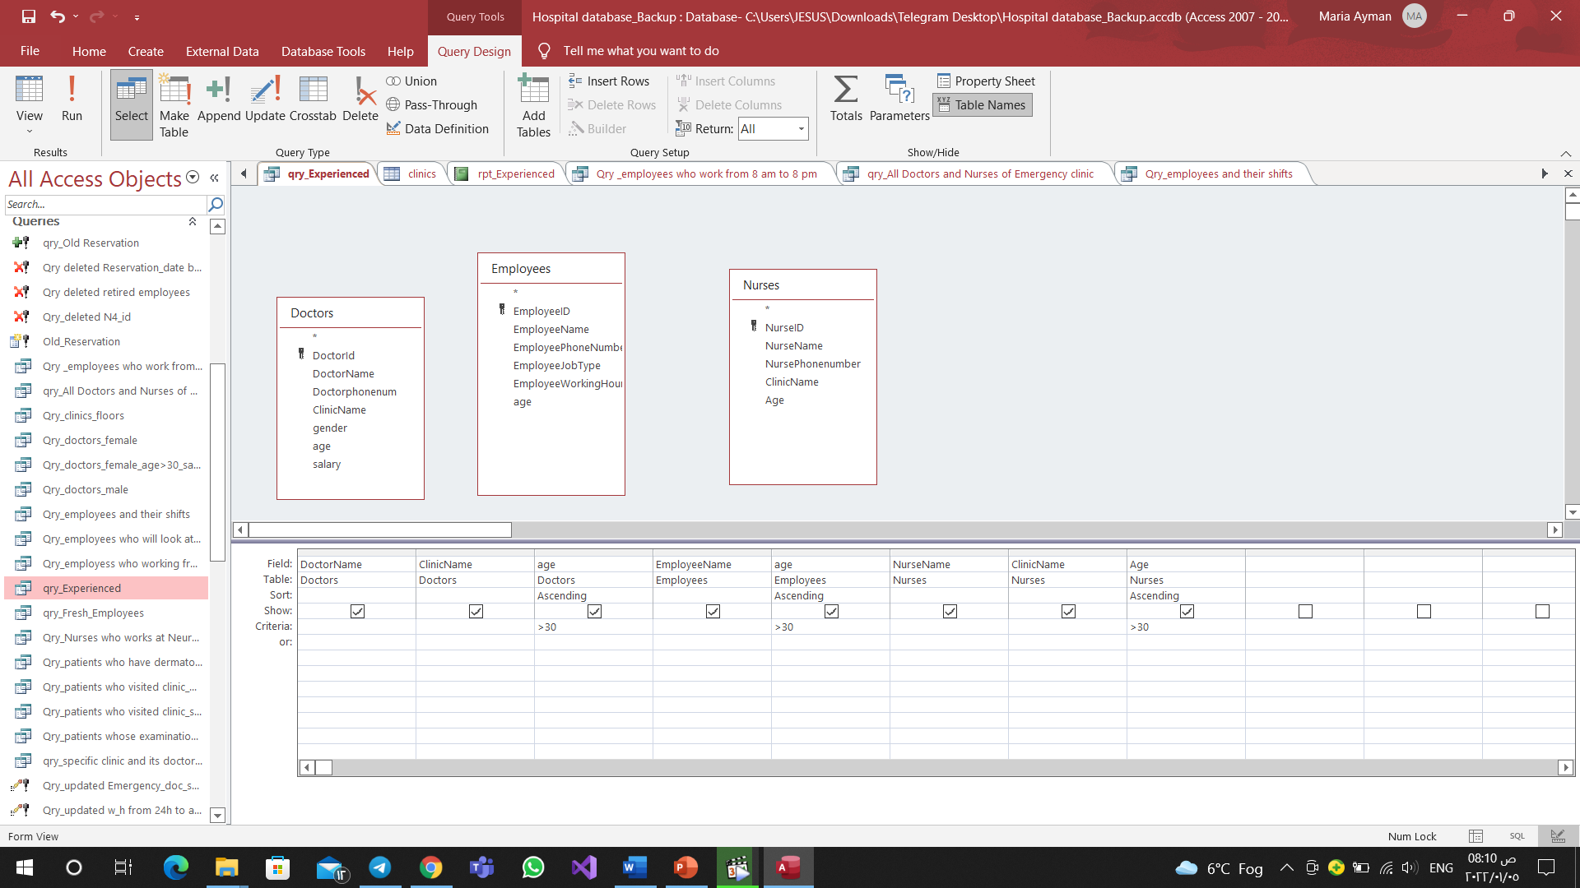
Select query from more than one table.

Slide 16
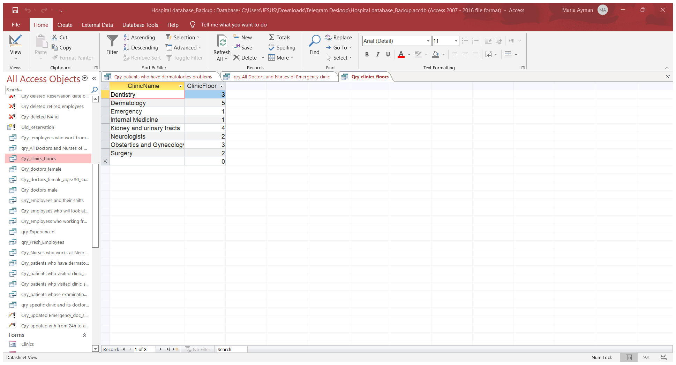
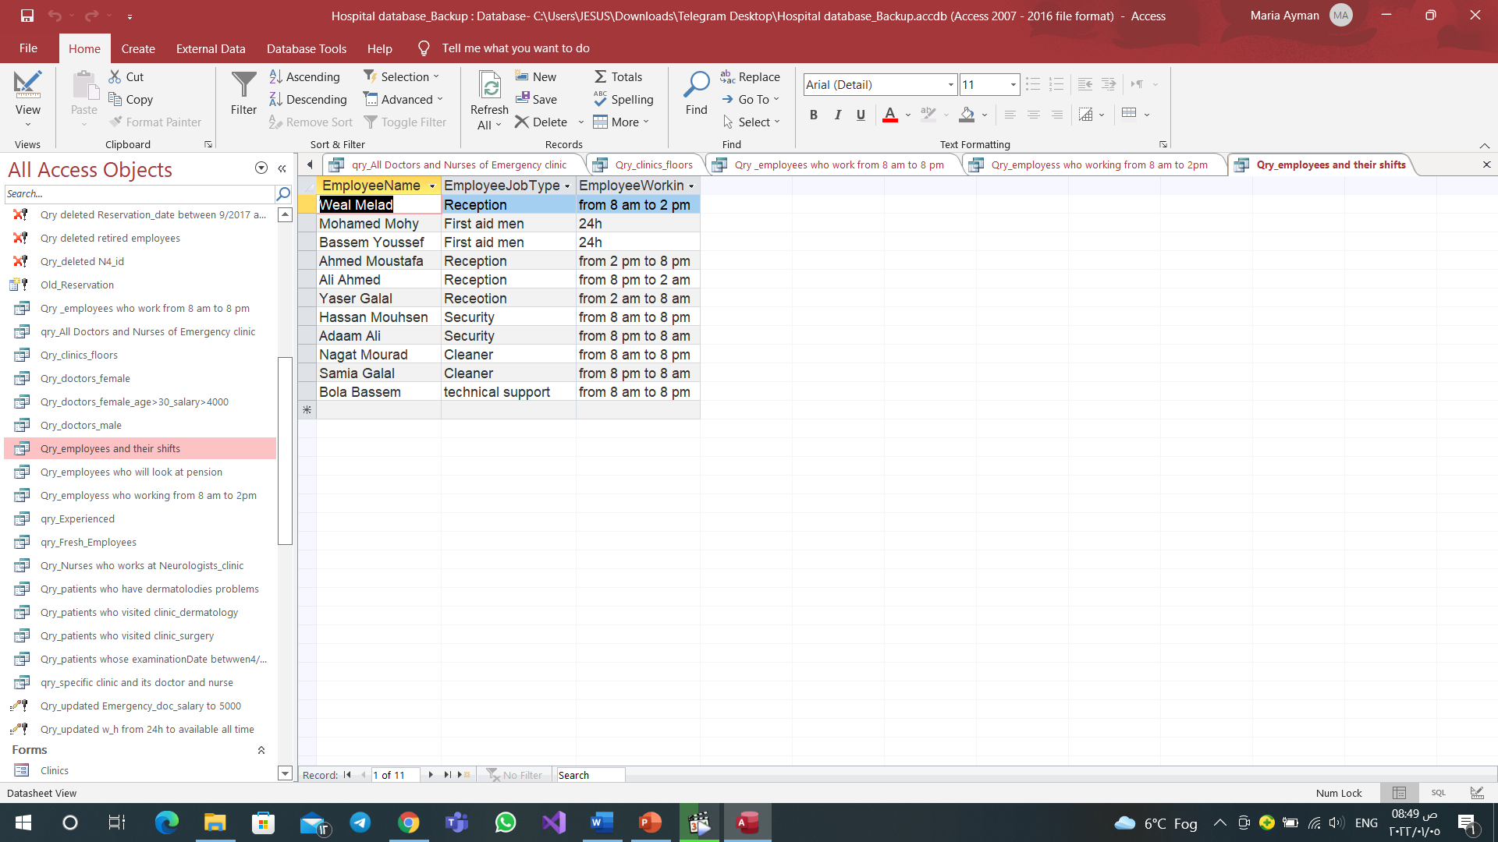
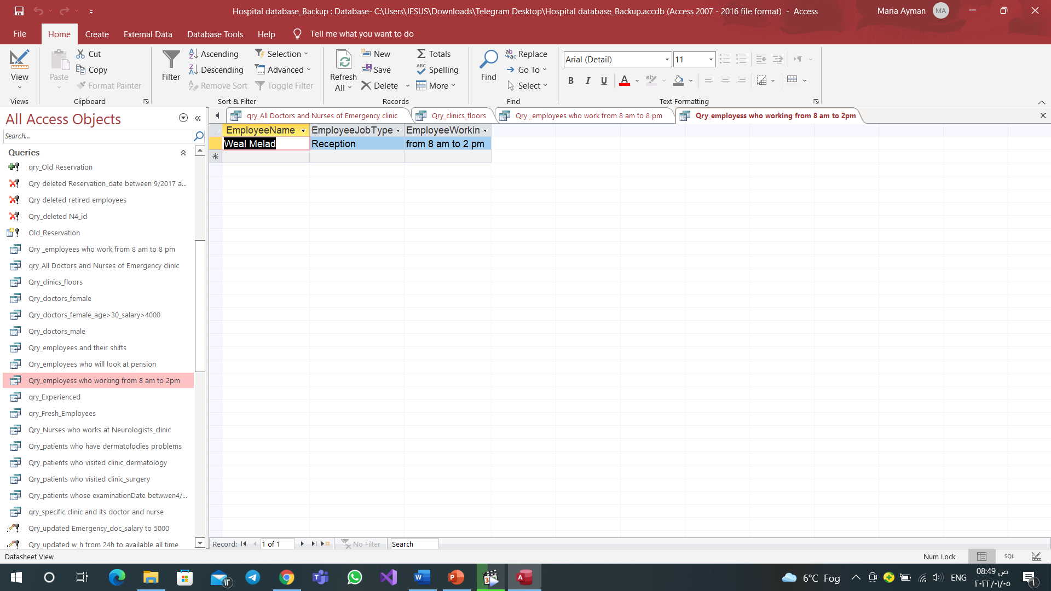
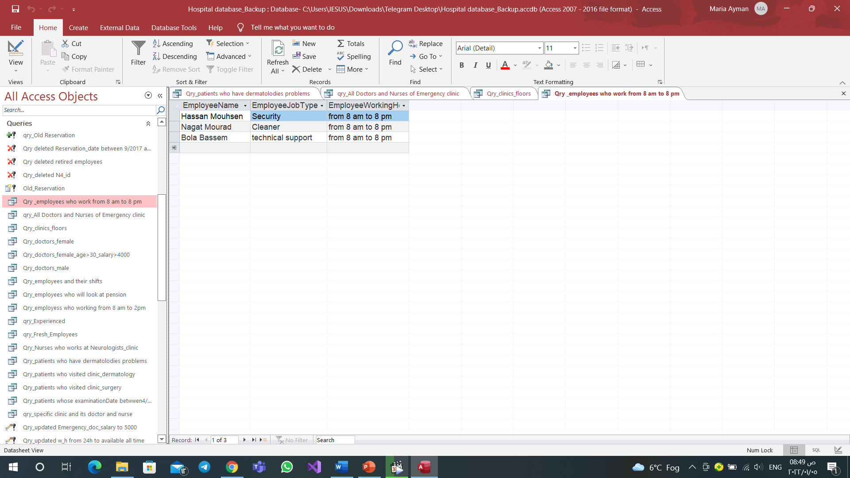
Query for number floor of every clinic. Query for shifts of employees.

Slide 17
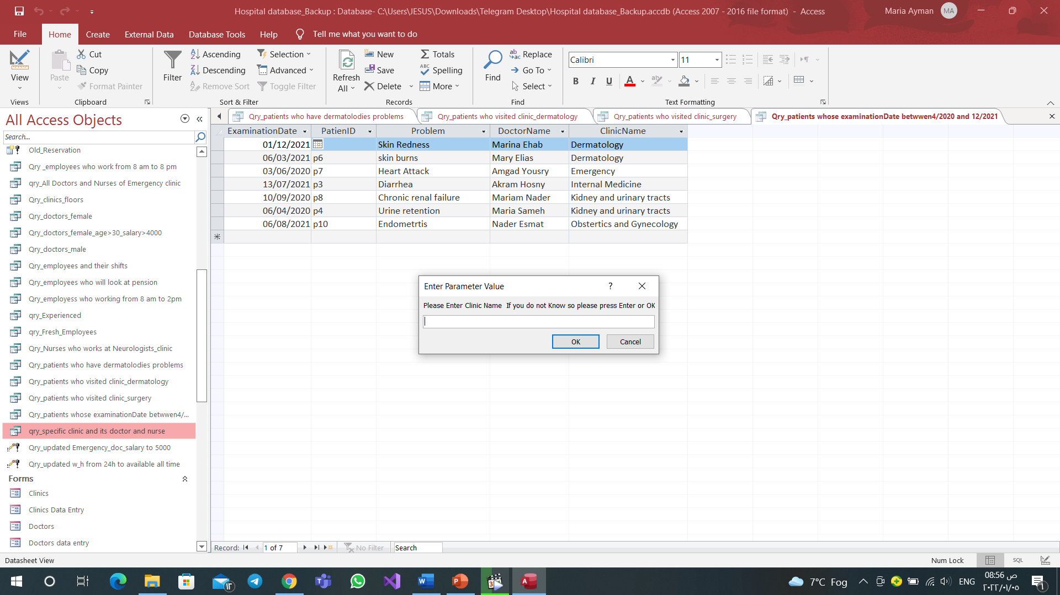
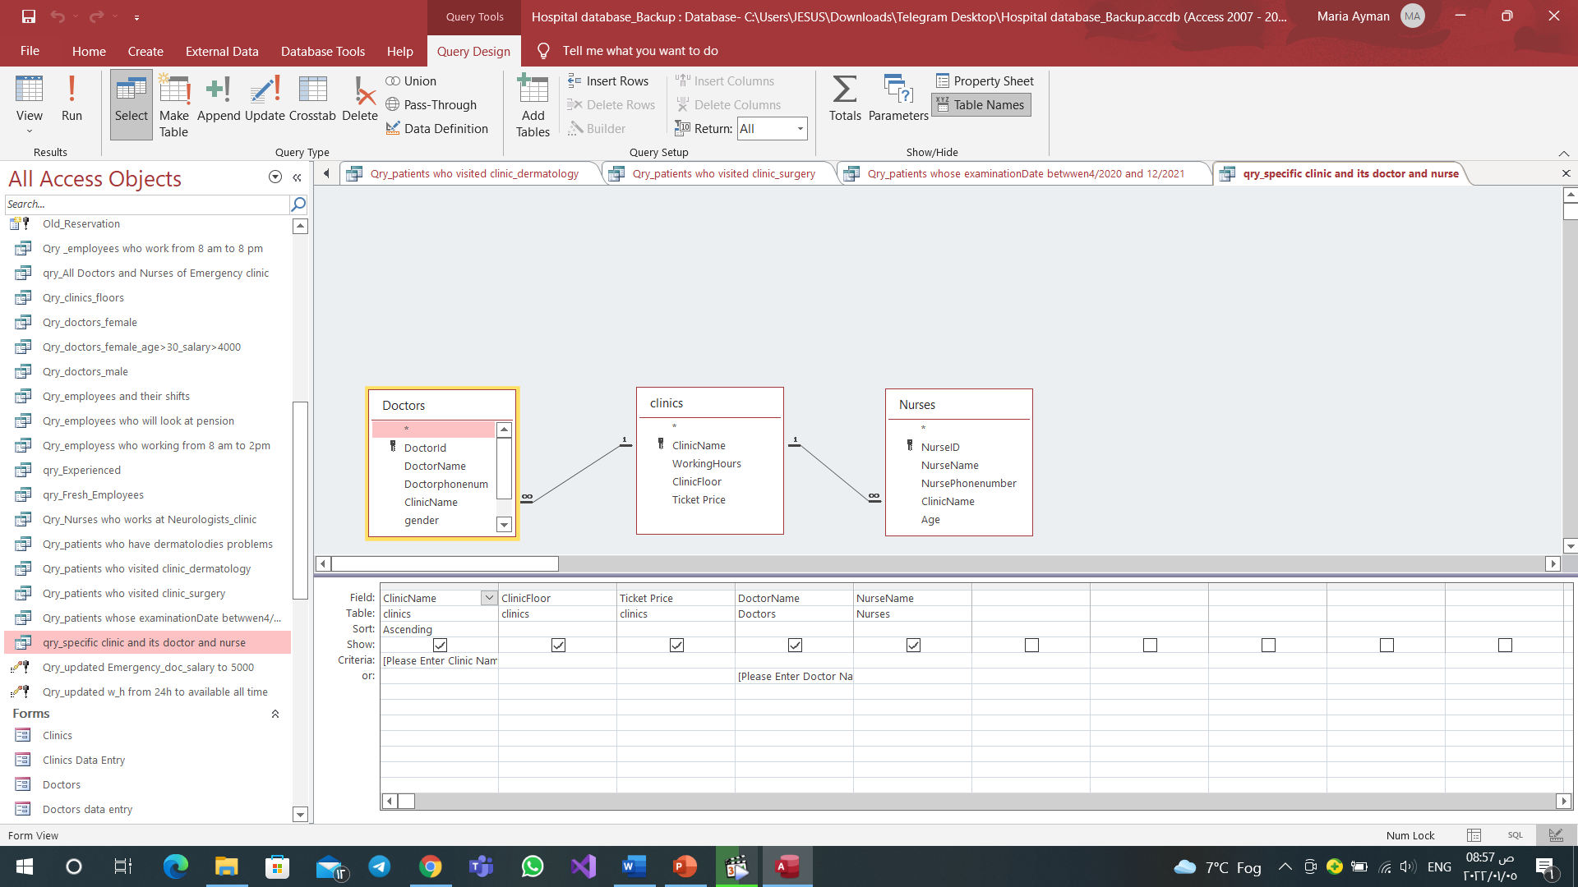
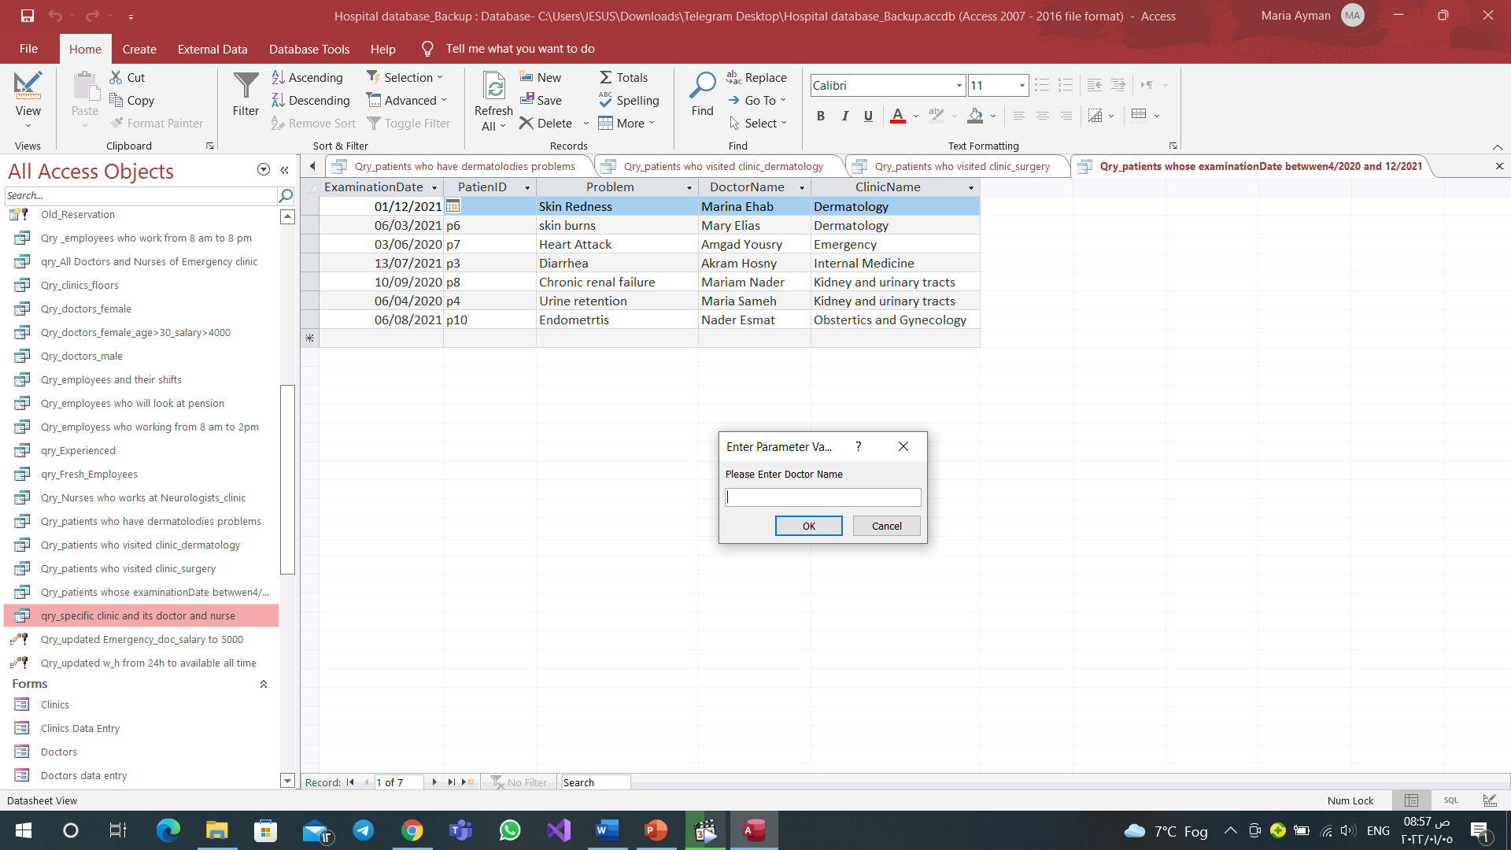
Parameter query

Slide 18
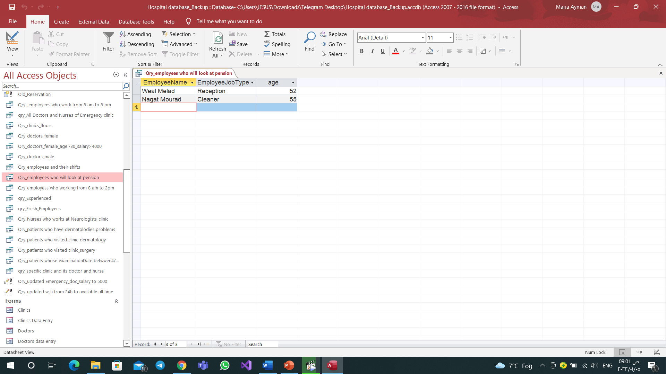
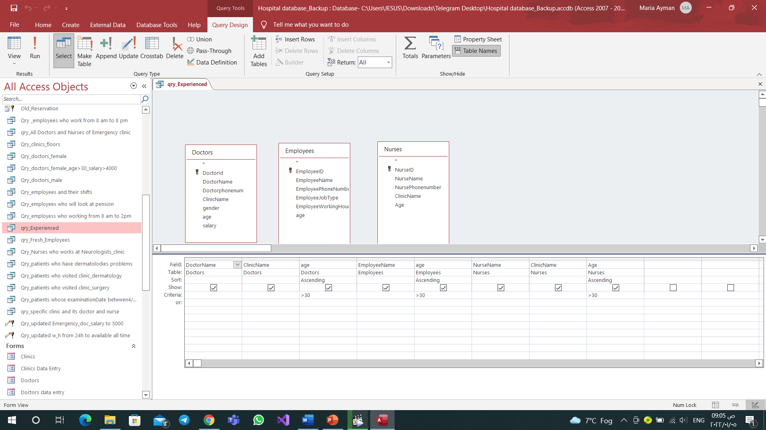
Query for employees who will look at pension
Queries for Experienced and Fresh Employees
Experienced→

Slide 19
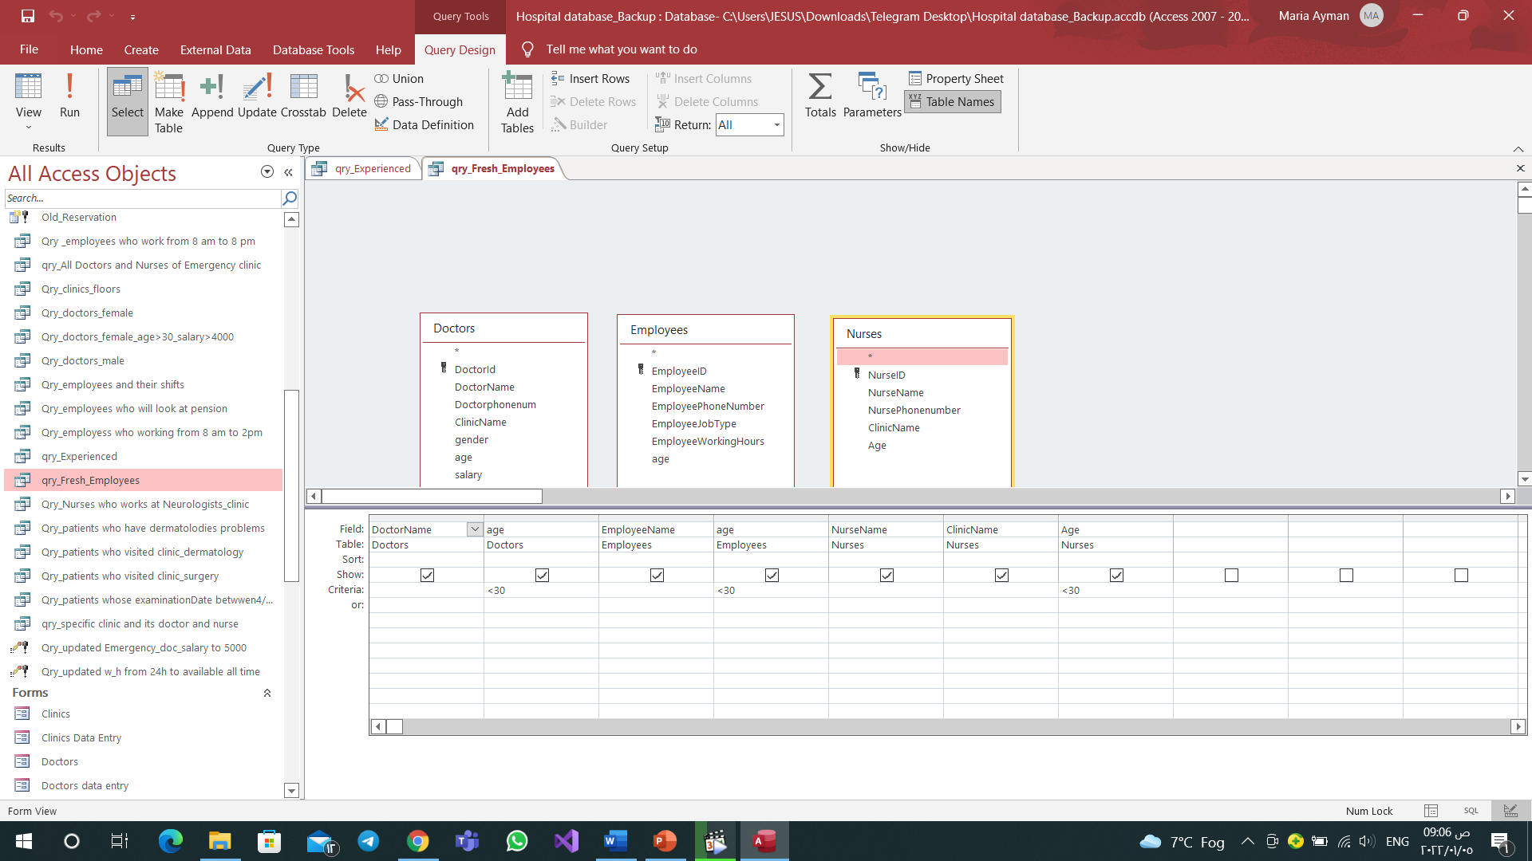
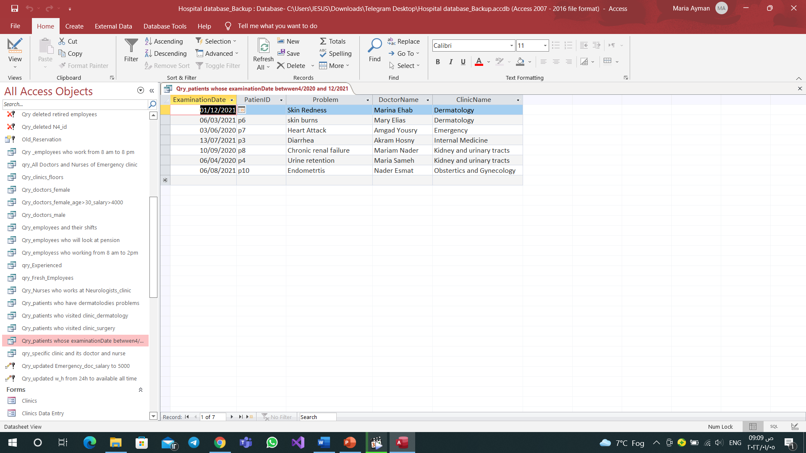
Query for Patients whose examination date between 4/2020 and 12/2021
Fresh→

Slide 20
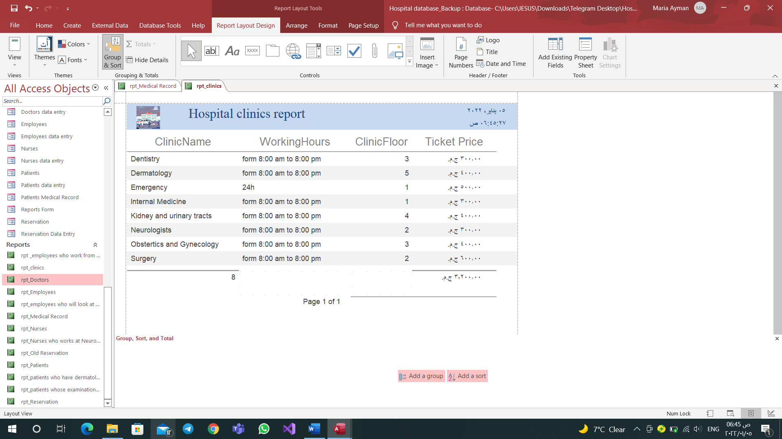
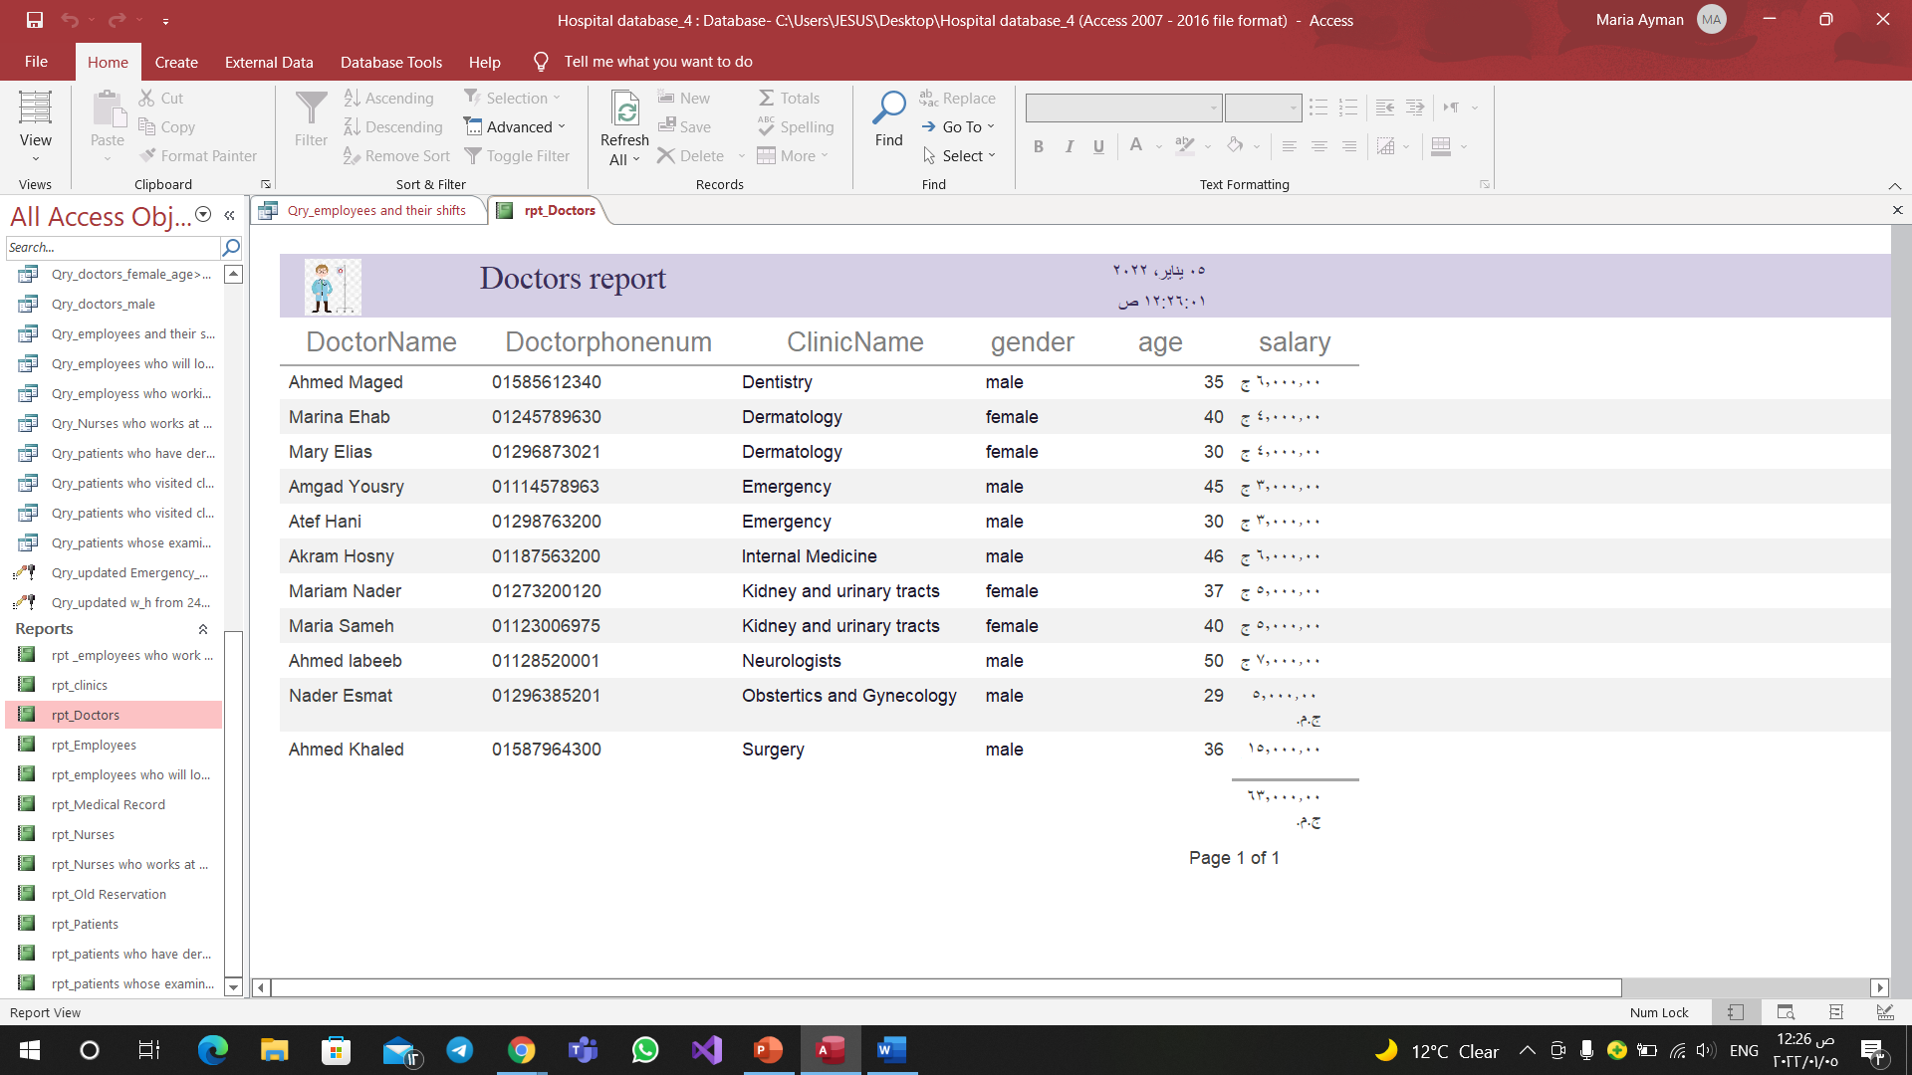
Reports
Clinics.
Doctors.

Slide 21
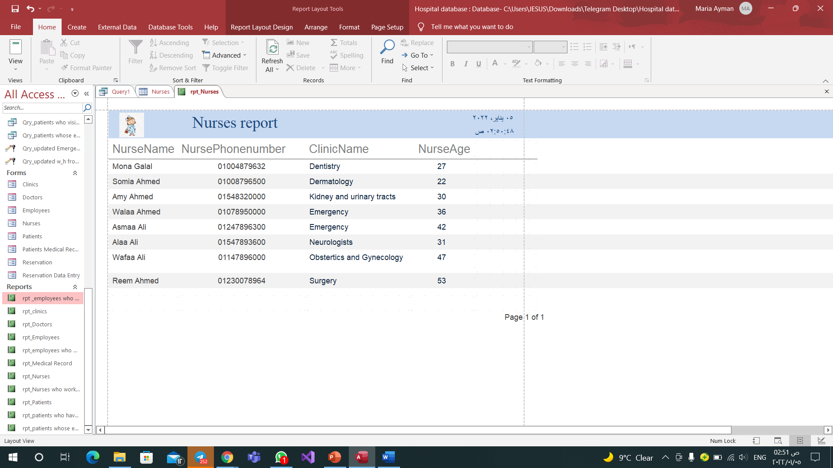
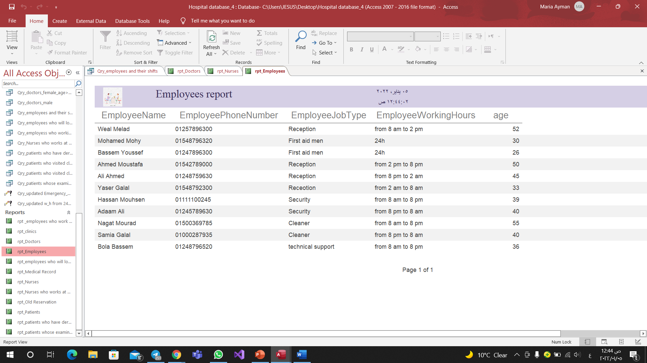
Nurses.
Employees.

Slide 22
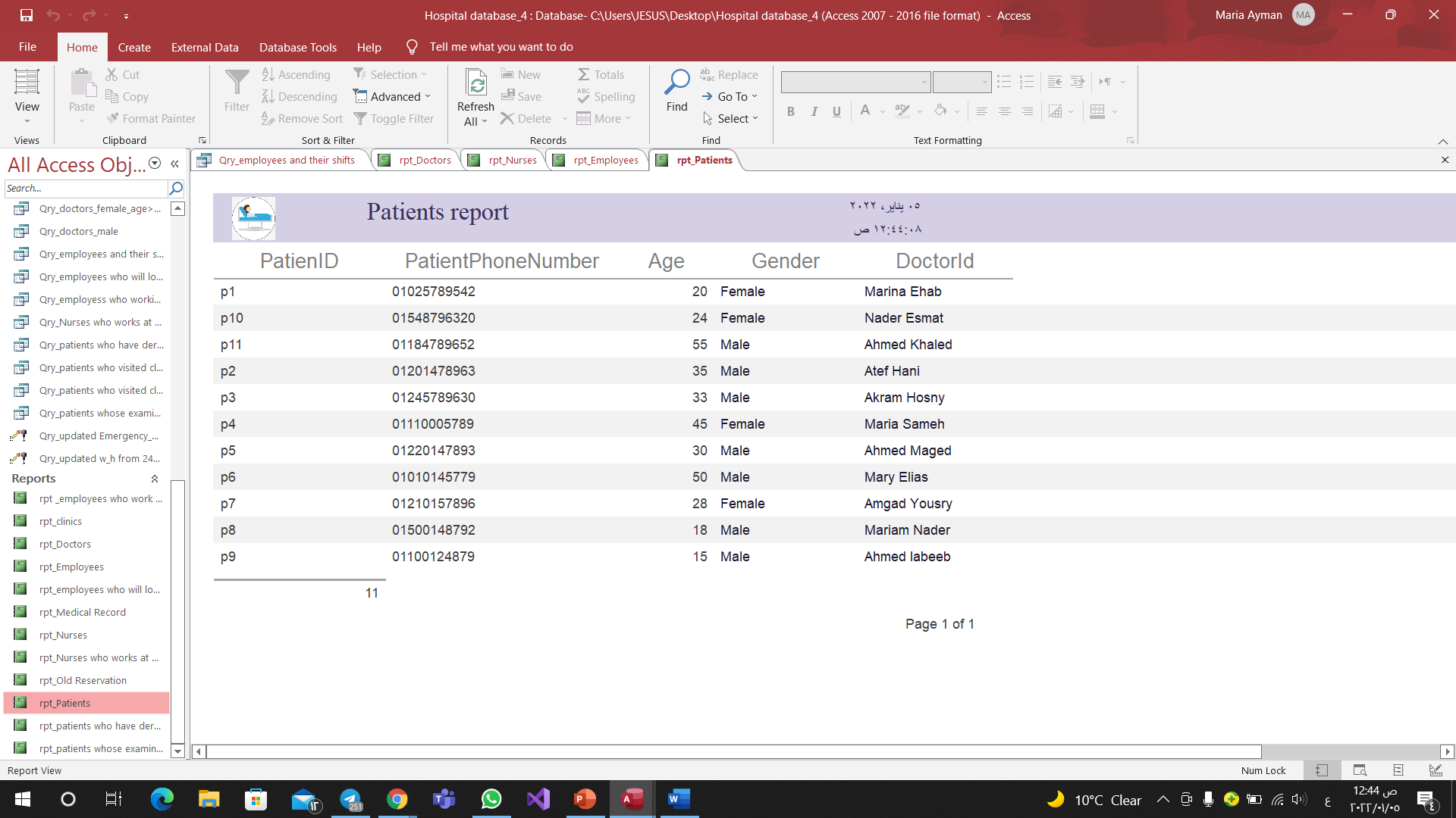
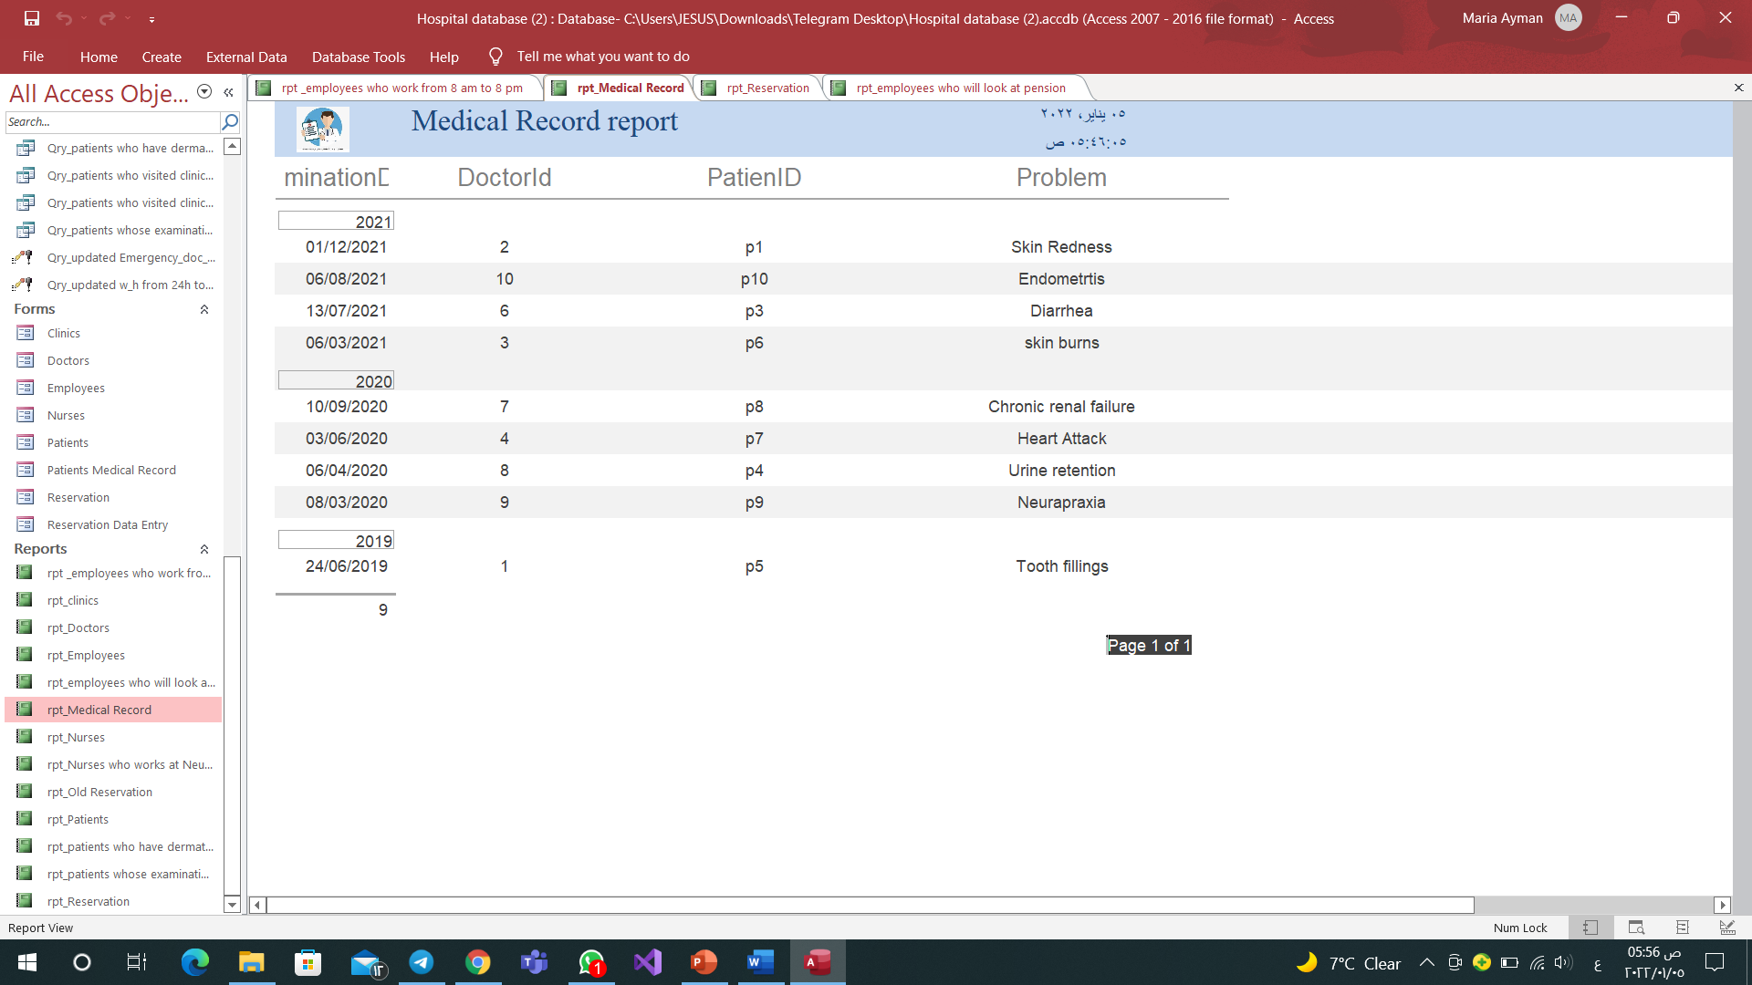
Patients.
Medical Record.

Slide 23
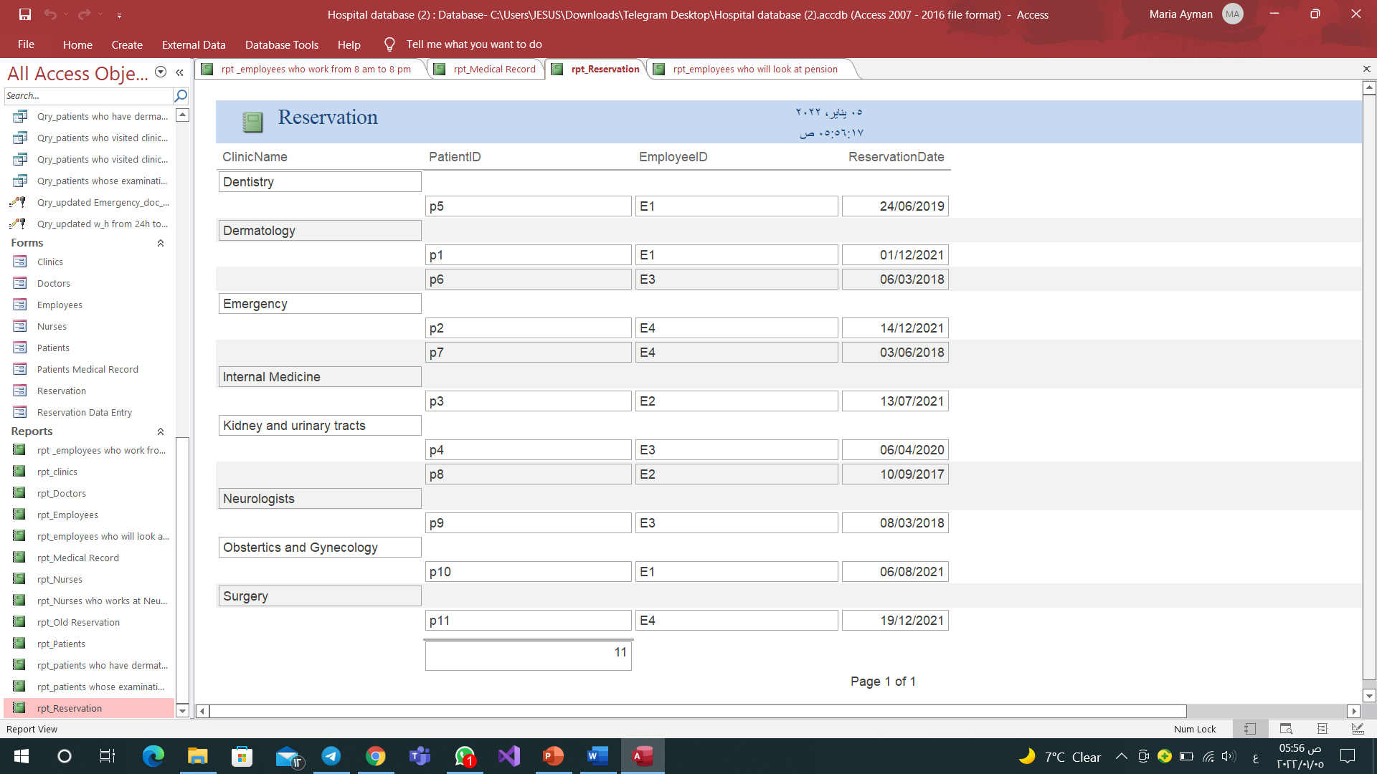
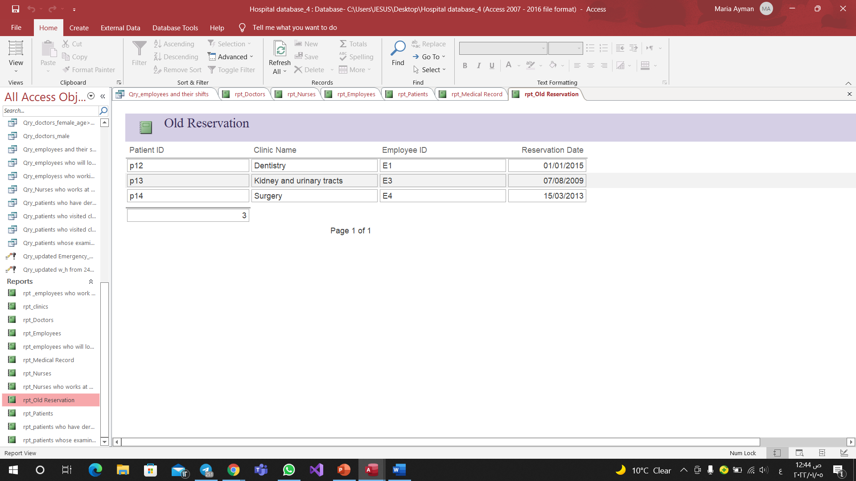
Reservation.
Old Reservation.

Slide 24
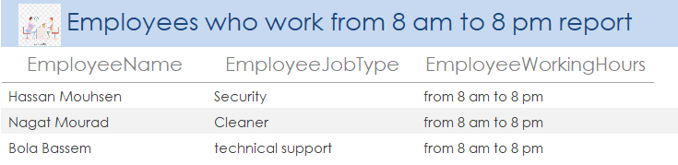
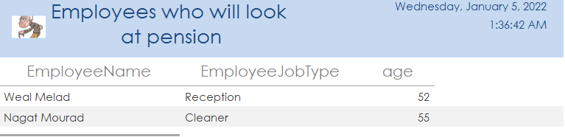
Employees who work from 8 am to 8 pm.
Employees who will look at pension.

Slide 25
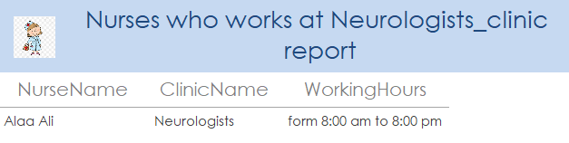
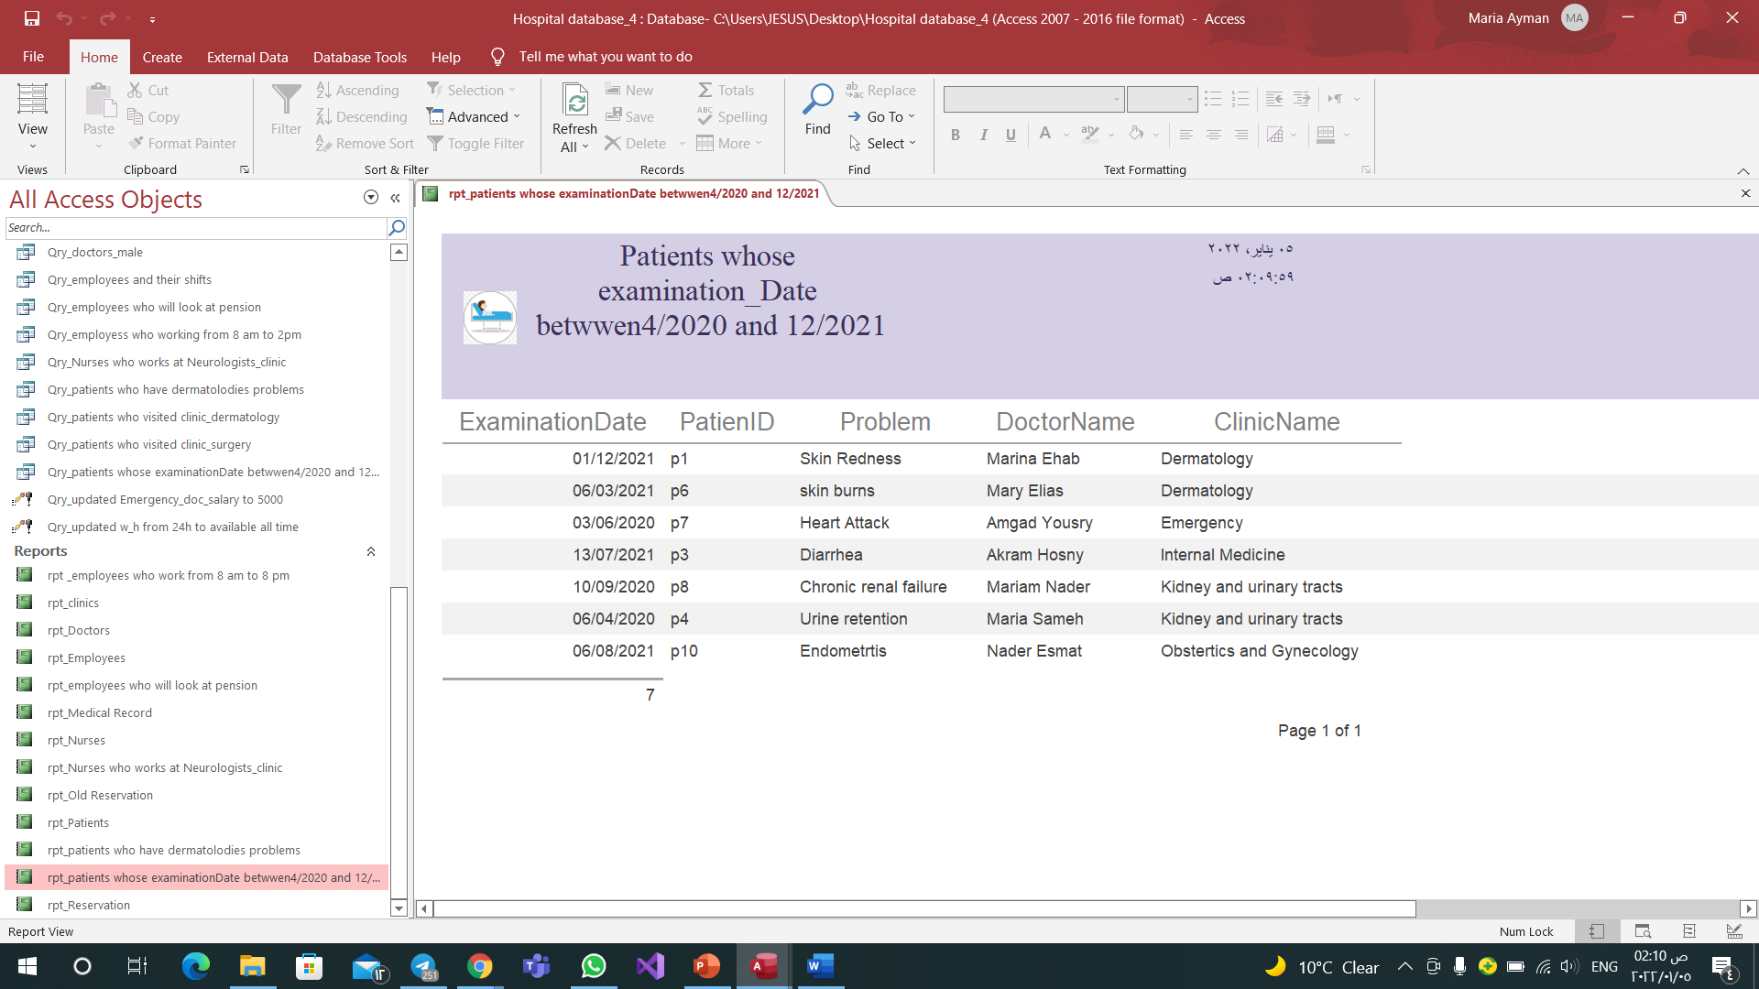
Nurses who work at Neurologists Clinic.
Patients whose examination date between (4/2020 and 12/2020).

Slide 26
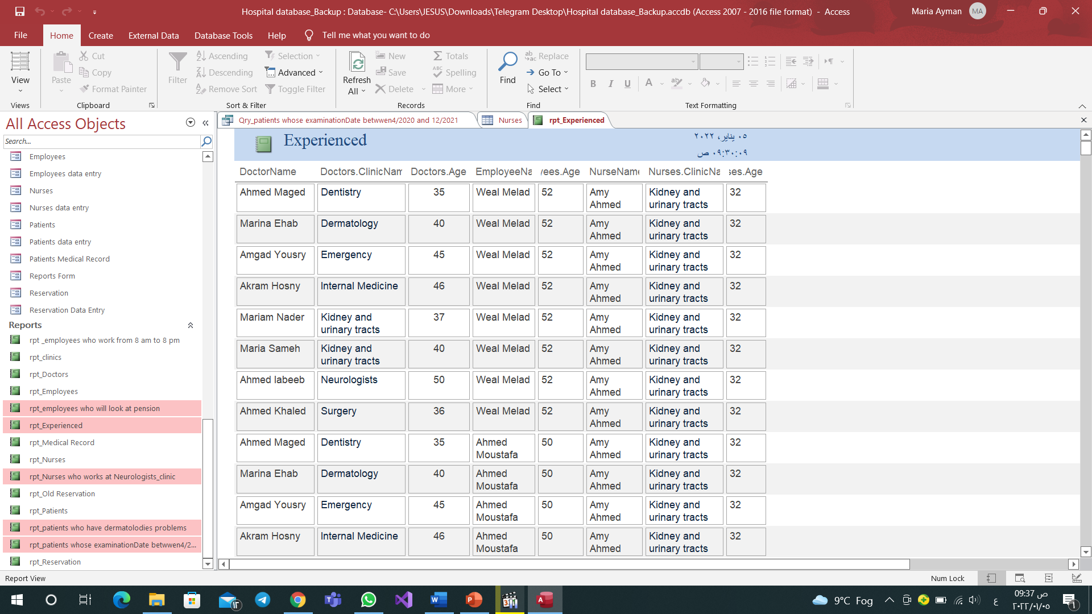
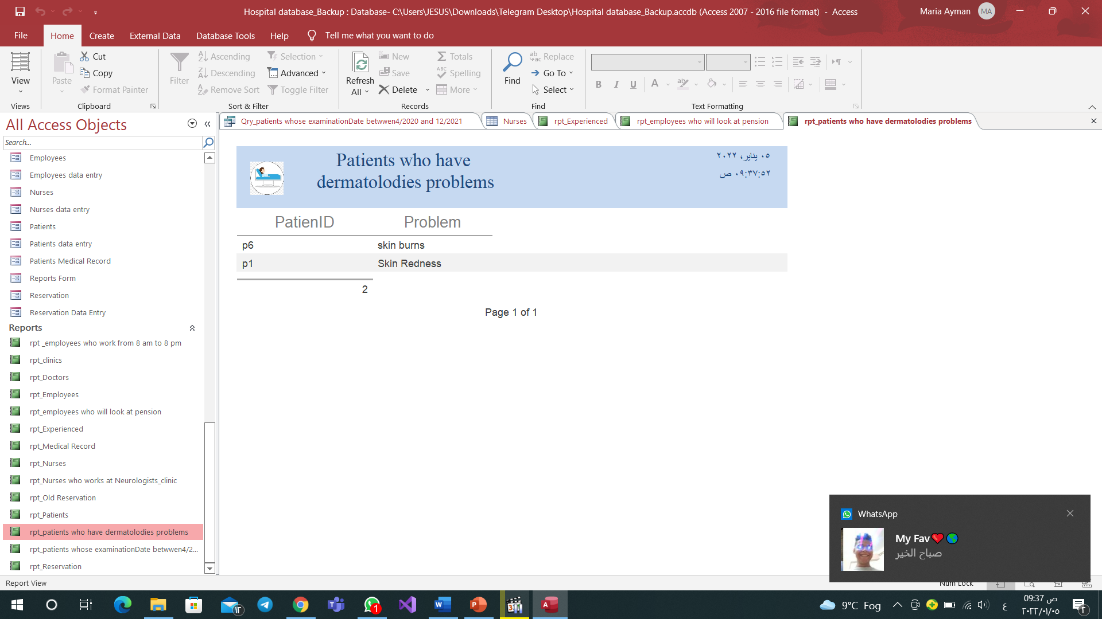
Experienced Employees. Patients who have dermatomyositis problems

Slide 27
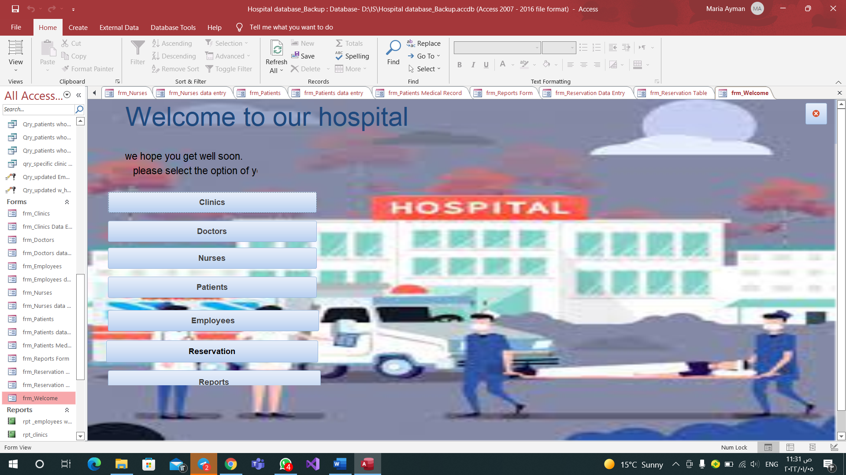
Forms (15)
Navigation form

Slide 28
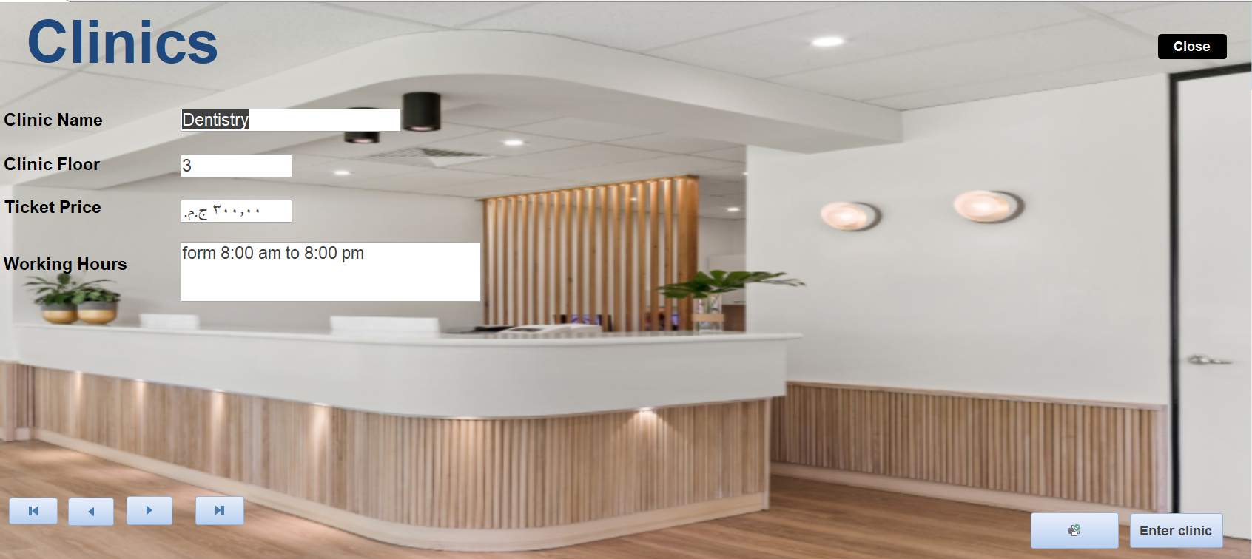
Clinics Form

Slide 29
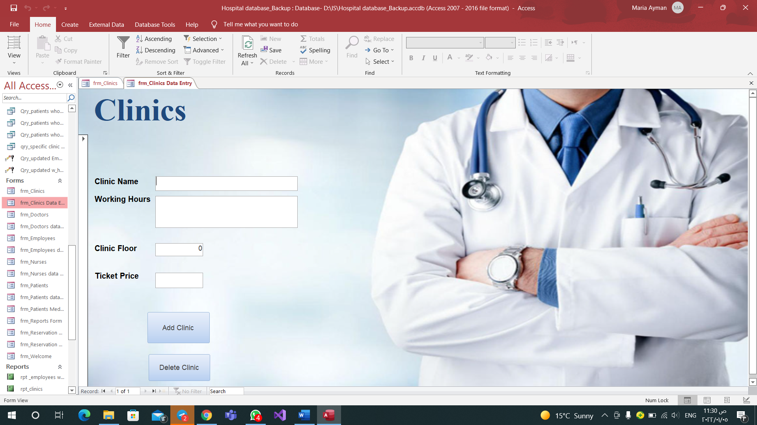
Clinics data entry form

Slide 30
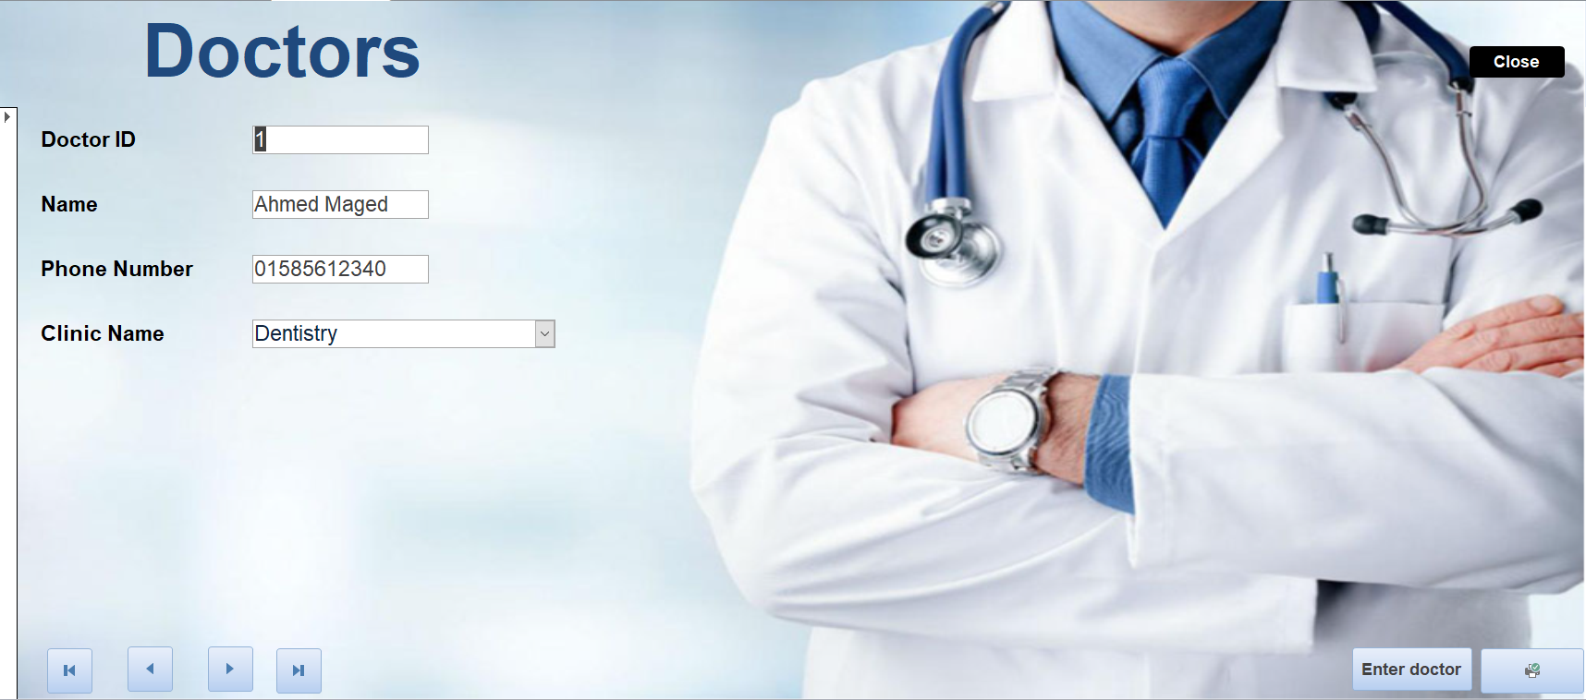
Doctors form

Slide 31
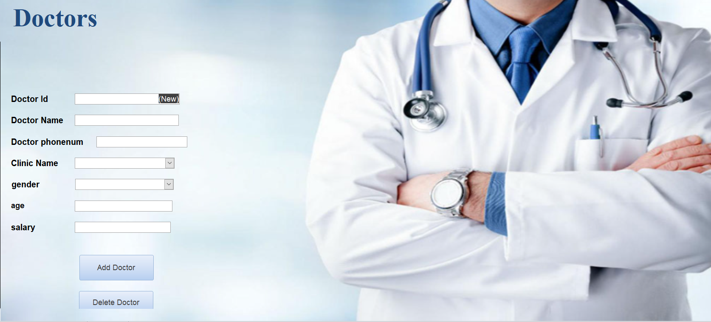
Doctors data entry form

Slide 32

Nurses form

Slide 33

Nurses Data Entry form

Slide 34

Employees form

Slide 35

Employees data entry form

Slide 36
Team Members
كلارا باسم فكري
ماريان أشرف بشري
كارن عصام ناجي
ماري جرجس حنا
ماريا ايمن ابراهيم
ماجي صموئيل فرح
ماجي حمدي وسيلي

Slide 37
You can find the Database on
https://github.com/mMariaAyman/Project_IS

Slide 38
Thank You

